Slide 1
Welcome to Music at Wylie

Slide 2
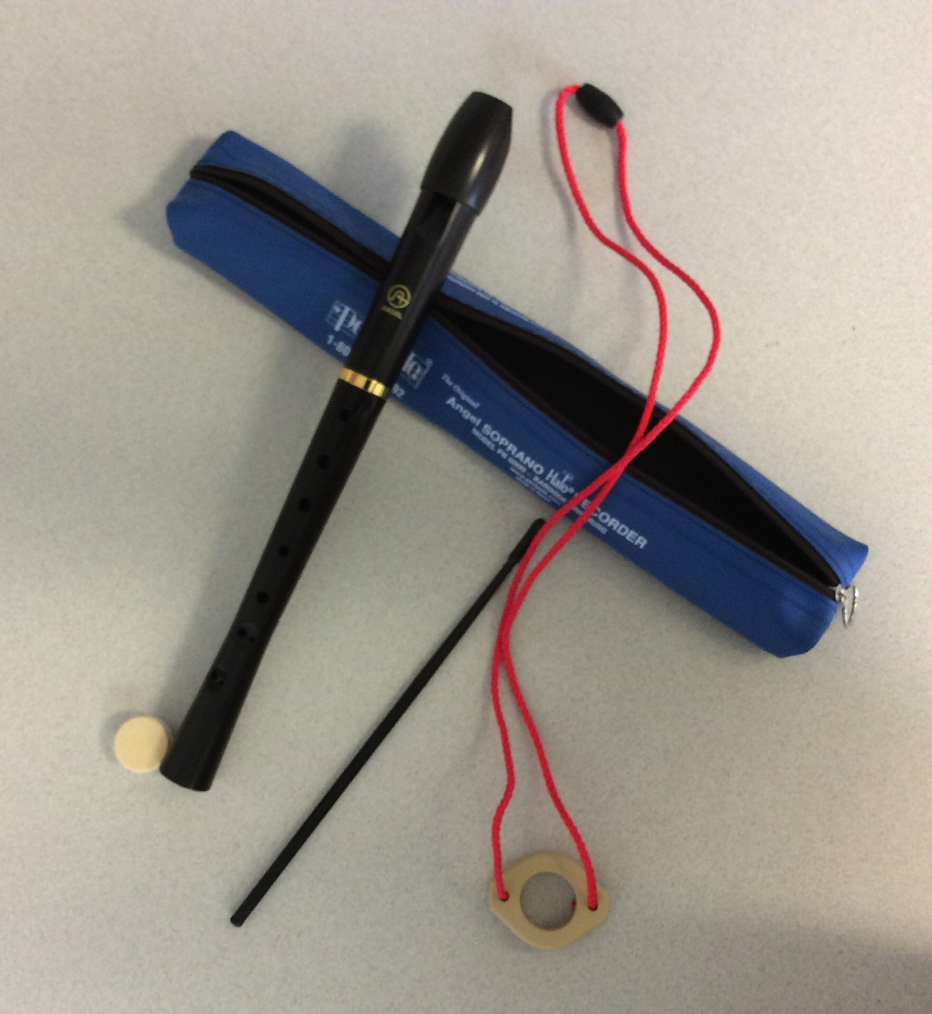
Recorders are Part of the 4th grade curriculum

Slide 3
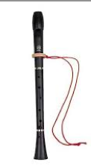
Each Student needs to have their own Recorder

Slide 4
There are three options for obtaining a recorder

Slide 5
Option Number 1
If there is a recorder at home that an older sibling used, your child can use that one.
Be sure to have your child bring it in so I can check it over and make sure it is in good working order.

Slide 6
Option 2
Purchase a recorder on Pay Schools
See the directions that follow.

Slide 7
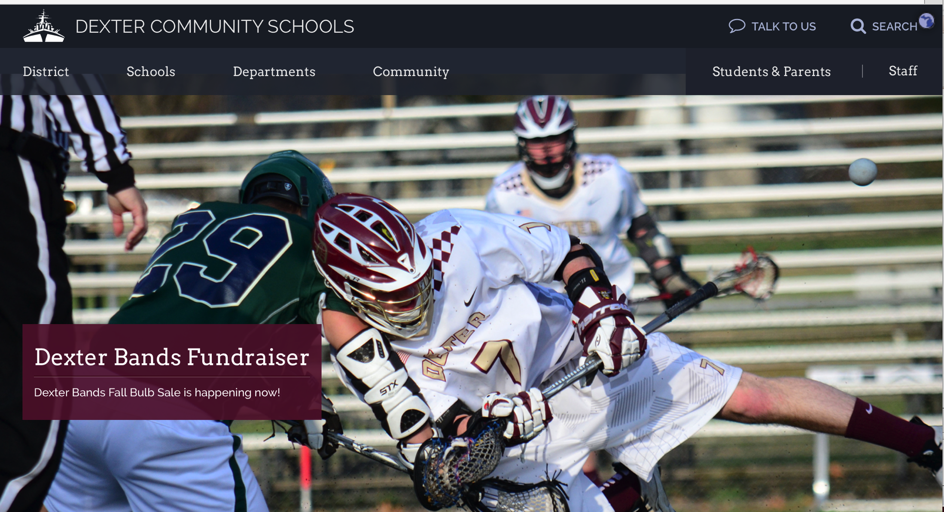
Go to the District Web Site

Slide 8
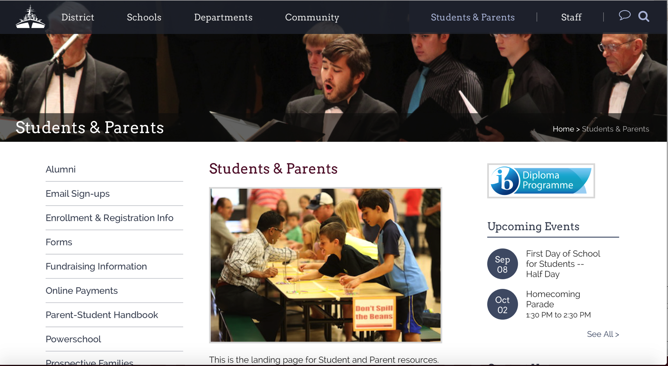
Click on the tab: Students and Parents

Slide 9
Click on ONLINE Payments
⬅

Slide 10
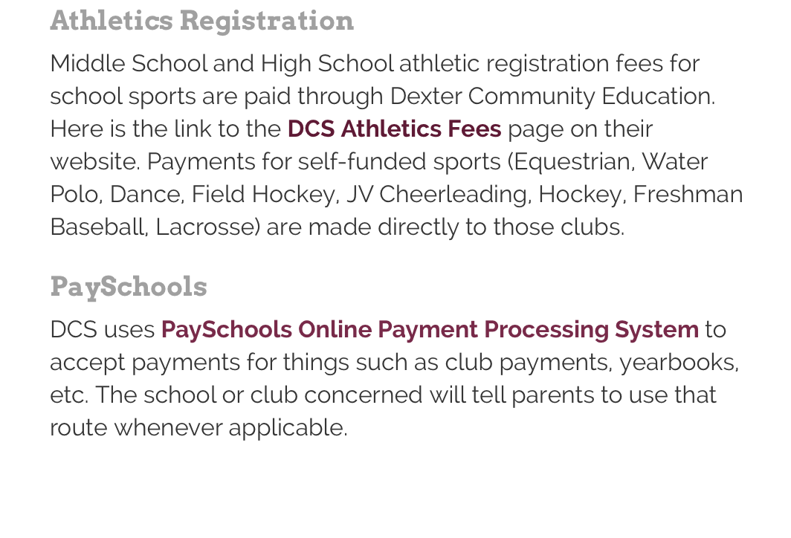
Go to the Bottom of the page to: payschools
⬅
⬅ Click here

Slide 11
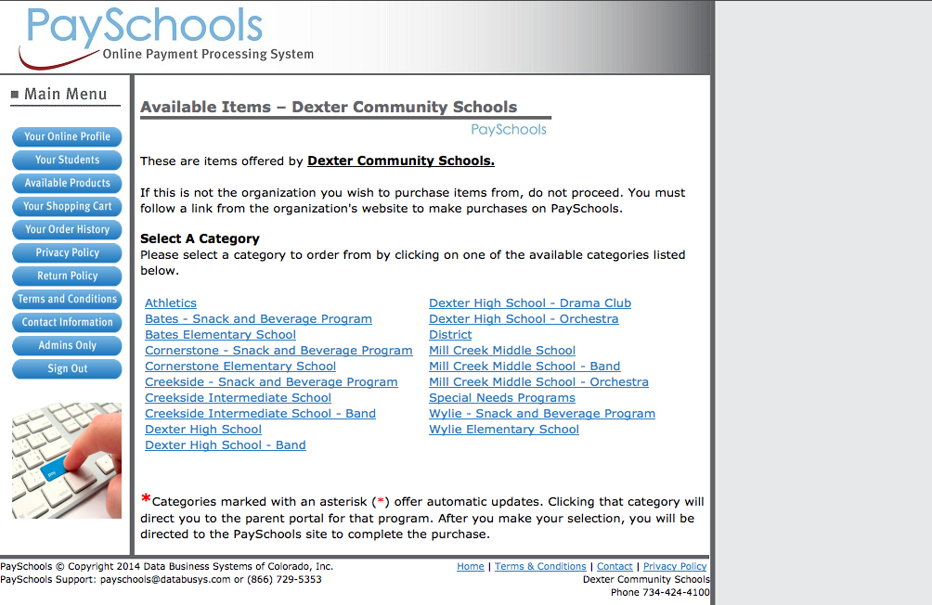
Click on Wylie Elementary School
⬅

Slide 12
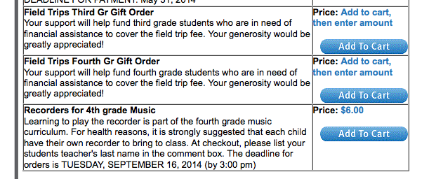
Scroll down to Recorders for 4th grade music and Click on Add to Cart

Slide 13
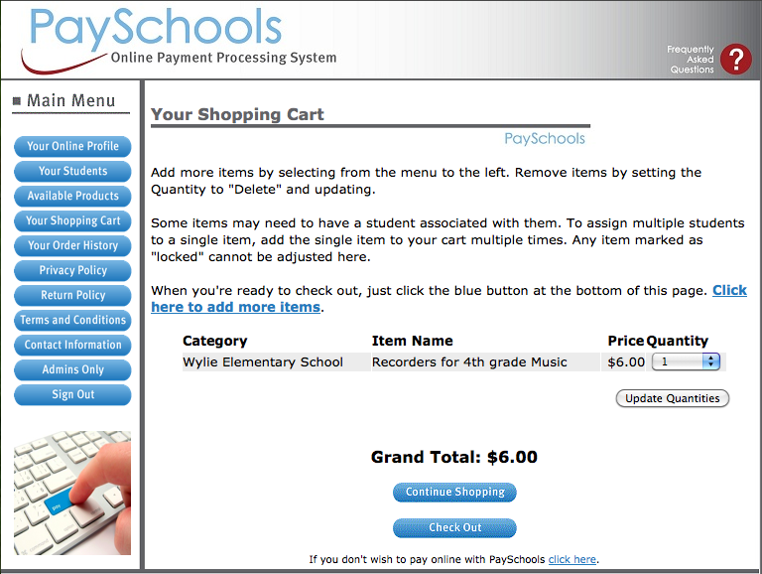
Select the quantity and Check out
⬅

Slide 14
Deadline to purchase is Wednesday, September 20, 2016 the cost is $6.00
Once all orders are in I will purchase them
through the company. Recorders will be
delivered to the school and distributed in class.

Slide 15
Option 3
If you do not have a recorder at home and do not wish to purchase a recorder I have a limited number of recorders that students can borrow for the year. These will be handed out in class and are to be returned at the end of the year. Cost for broken or lost recorders is $6.

Slide 16
Go to my Website: http://thielemusic.weebly.com To review this powerpoint or email me at thielem@dexterschools.org if you have questions.

